Slide 1

GLOBAL PARTNERSHIP FOR SUSTAINABLE DEVELOPMENT GOALS

Slide 2
Development of civil Society
The activities of non-governmental organizations
The preservation of peace and international security
Implementation of the concept of sustainable development at a global level
International environmental policy of the Republic of Kazakhstan
Astana "Green Bridge“ initiative

Slide 3
The Global Partnership helps nations, business and organizations work better together to end poverty.
It brings governments, private companies, civil society and others together to ensure funding, time and knowledge produce maximum impact for development.

Slide 4

A successful sustainable development agenda requires: partnerships between governments, the private sector and civil society.
These inclusive partnerships built upon principles and values, a shared vision, and shared goals.

Slide 5
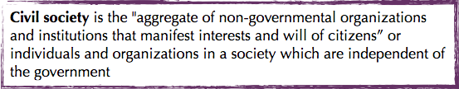


Development of civil Society

Slide 6


Development of civil Society

Slide 7


Development of civil Society

Slide 8
Development of civil Society
Civil society development engages people, organizations, and government bodies to work in partnership to improve their communities and foster good governance.
Civil Society activities contribute to a more open, participatory and more dynamic democratic society, enriching the political agenda and the public debate.

Slide 9
Civil society organizations
Civil society organizations play a significant role in international development cooperation. As a token of solidarity, a number of European states assisted developing countries’s strive for political and socio-economic development well before establishing the European Union and institutionalizing the European policy for nongovernmental sector development.

Slide 10
The activities of non-governmental organizations
What is non-govermental organizations?
A non-governmental organization (NGO) is an organization that is neither a part of a government nor a conventional for-profit business.

Slide 11
NGOs are highly diverse groups of organizations engaged in a wide range of activities, and take different forms in different parts of the world. Some may have charitable status, while others may be registered for tax exemption based on recognition of social purposes. Others may be fronts for political, religious or other interest

Slide 12
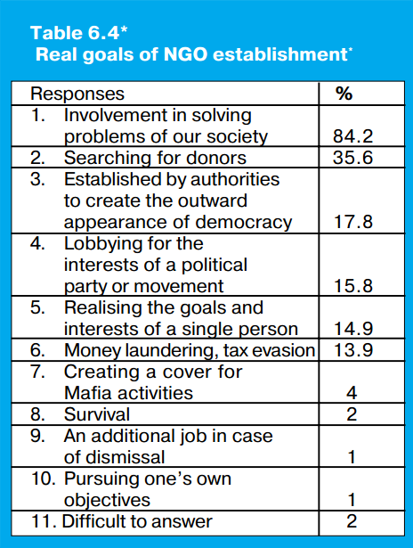
Goals of NGO establishment

Slide 13
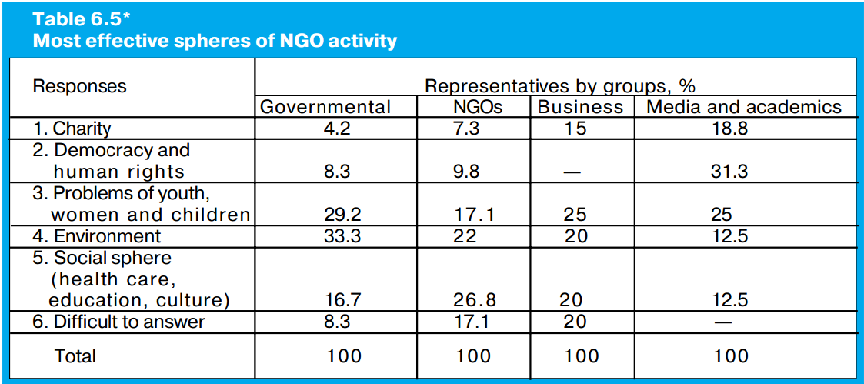
Most effective spheres of NGO activity

Slide 14
The activities of non-governmental organizations
These organisations always do different help assistance. For example there is disaster somewhere, then these CSOs give them financial and food assistance. Or fight for human rights in problematic countries. These activities are connected in the same way with ecology, health, economical problems
Activities can pass from one family till big companies, cities, countries and worldwide. For example in the Day of Earth millions of families turn of their electricity for about an hour.

Slide 15

Non-governmental organizations (NGO) in Kazakhstan were organized and worked from Soviet period, but actively began to develop with reorganization arrival. Now there are recognized leaders, which names constantly very famous, there are also small organizations created by enthusiasts, and simply desperate people who, there not less, decided to solve the problems by creation of NGO. For NGO there is also the term - "The third sector.

Slide 16
Preservation of peace and international security
The INTERNATIONAL SECURITY - the system of the international relations based on observance by all states of the conventional principles and norms of international law, excluding the solution of controversial issues and disagreements between them by means of force or threat. The principles of the international security provide the adoption of peaceful co-existence as the universal principle of the interstate relations, ensuring equal safety for all states, creation of effective guarantees in military, political, economic and humanitarian areas - prevention of race of arms in space,
the termination of all tests of the nuclear weapon and its complete elimination; dissolution of military groups;
unconditional respect of the sovereign rights of each people;

Slide 17
fair political settlement of the international crises and regional conflicts;
confidence-building between the states;
development of effective methods of prevention of the international terrorism;
eradication of genocide, apartheid, sermon of fascism;
an exception of the international practice of all forms of discrimination, refusal of economic blockade and sanctions (without recommendations of the world community);
establishment of the new economic order ensuring equal economic security of all states.

Slide 18
:The principles of the international security provide
the adoption of peaceful co-existence as the universal principle of the interstate relations;
ensuring equal safety for all states;
creation of effective guarantees in military, political, economic and humanitarian areas;
prevention of race of arms in space, the termination of all tests of the nuclear weapon and its complete elimination;
unconditional respect of the sovereign rights of each people;

Slide 19
fair political settlement of the international crises and regional conflicts;
confidence-building between the states;
development of effective methods of prevention of the international terrorism;
eradication of genocide, apartheid, sermon of fascism;
exception of the international practice of all forms of discrimination, refusal of economic blockade and sanctions (without recommendations of the world community);
establishment of the new economic order ensuring equal economic security of all states.

Slide 20
Implementation of the concept of sustainable development at a global level
The idea of sustainable development grew from numerous environmental movements in earlier decades. Summits such as the Earth Summit in Rio, Brazil, 1992, were major international meetings to bring sustainable development to the mainstream.
At the 1992 UN Conference on Environment and Development (theEarth Summit), the Convention on Biological Diversity (CBD) was born. 192 countries, plus the EU, are now Parties to that convention. In April 2002, the Parties to the Convention committed to significantly reduce the loss of biodiversity loss by 2010.

Slide 21
Twenty years ago at the 1992 Earth Summit in Rio, countries adoptedAgenda 21 — a blueprint to rethink economic growth, advance social equity and ensure environmental protection. Marking that anniversary, this year sees Rio+20, the UN Conference on Sustainable Development, with aims to get bold agreements to address things like poverty, sustainable development, decent jobs, etc.
Twenty four years ago at the 1992 Earth Summit in Rio, countries adopted Agenda 21 — a blueprint to rethink economic growth, advance social equity and ensure environmental protection. Marking that anniversary, this year sees Rio+20, the UN Conference on Sustainable Development, with aims to get bold agreements to address things like poverty, sustainable development, decent jobs, etc.

Slide 22
The concept of a sustainable development can be analysed in several principles.
1. Political legal principle:
- the developed modern democracy (democracy, the constitutional power, the constitutional state);
- system of the reasonable legislation and taxation;
- social justice (worthy payment for work, observance of human rights);
- friendship of the people, mutual responsibility of the citizen and society;

Slide 23
2. Economic principle:
- civilized product-market economy;
- free competition of producers and sellers;
- production, the cultural benefits in enough for satisfaction of the basic vital needs of all inhabitants of the planet;
- effective and humane stimulants of useful activity of inhabitants.
3. Ecological principle:
- providing a koevolution of society and the nature, the person and the biosphere, restoration of harmony between them, formation of a noosphere;
- preservation of real opportunities not only present, but also for future generations to satisfy the basic vital needs;
- rational use of natural resources;

Slide 24
International environmental policy of the Republic of Kazakhstan
Public Non-Governmental Environmental Organisations
In Kazakhstan there are more than 3000 non-governmental public organisations of various directions. These are children’s, school, women’s, environmental, and educational organisations, Media and others. More than 300 NGOs are dealing with the environmental and health issues.
One of the most important campaigns was “Semey-Nevada”. The anti-nuclear movement "Nevada Semipalatinsk" was formed in 1989 and was one of the first major anti-nuclear movements in the former Soviet Union. It was led by author Olzhas Suleimenov. The Soviet Union conducted 456 nuclear weapons tests at the Semipalatinsk Test Site, between 1949 and 1989. According to UNESCO, Nevada-Semipalatinsk played a positive role in promoting public understanding of "the necessity to fight against nuclear threats"

Slide 25
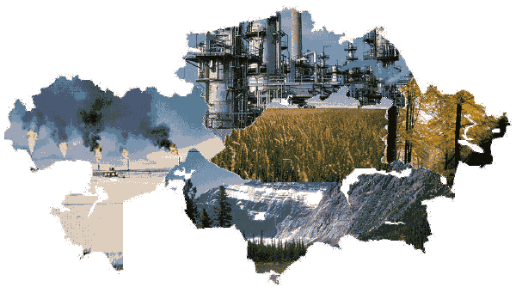
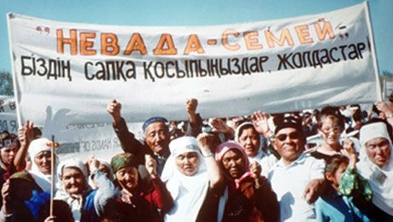
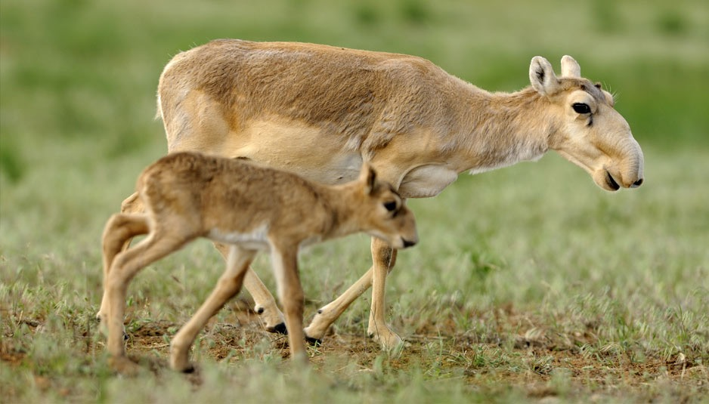
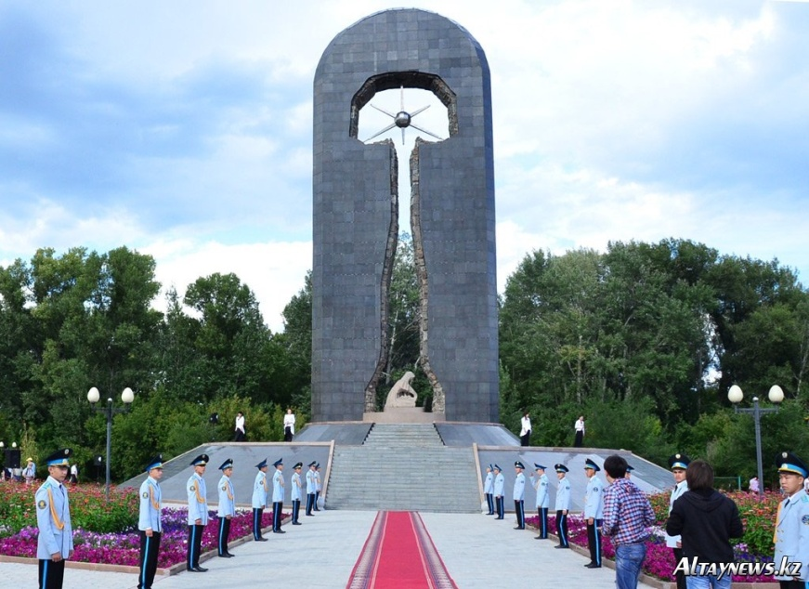

Slide 26
International environmental policy of the Republic of Kazakhstan
Good political, legal and institutional framework has been created in the last years for the successful solving of environmental issues in Kazakhstan.
The main goals of current structural policy are diversification and the strengthening of the non-oil sector. A number of development agencies and research centers (Development Institutions) have been established and the Government is looking at establishing techno and science parks to support the diversification of higher-value added industries. But there are certain obstacles inherited from the past to quickly achieve this.

Slide 27
According to certain estimates, in the next 10 years the oil and gas sector of the country, particularly the Kazakh sector of the Caspian Sea, could attract between to 150-200 bln. US$. At the same time, the Kazakhstan Government's top priority is to encourage foreign direct investments into industry, agriculture, innovation, processing sectors in order to decrease the dependence of the Economy of Kazakhstan on energy and extracting sectors and to ensure continued growth of Kazakhstan's economy.

Slide 28
Astana "Green Bridge“ initiative
The overarching goal of the Astana Initiative, adopted in 2010, is the development of regional, interregional and intersectorial cooperation, and the creation of the environment for introduction of green economy principles in Europe and Asia and the Pacific.

Slide 29
The initiative was adopted at the VI Ministerial Conference on Environment and Development in Asia and the Pacific in October 2010 and approved by the UNECE Committee on Environmental Policy for discussion at the VII Pan European Conference "Environment for Europe" to be held in September 2011 in Astana.
The Astana ?Green Bridge? Initiative is a bridge between: Europe and Asia and the Pacific; business and environment; developed and developing countries; science and practice; economy growth and conservation of natural resources; intellectual property and general accessibility to them.

Slide 30

Astana “Green Bridge” initiative
THE ASTANA "GREEN BRIDGE" INITIATIVE - START FOR THE TRANSITION TO A "GREEN" ECONOMY
The green economy is defined as an economy that aims at reducing environmental risks and ecological scarcities, and that aims for sustainable development without degrading the environment.
Kazakhstan is part of Europe and Asia and this area is very important for the ecology and economy of the world.

Slide 31
Astana “Green Bridge” initiative
Green Bridge Initiative
New Opportunities for Cooperation and trans-regional Green Business
• Renewable Energy and Energy Efficiency
• New technologies
• Organic agriculture and ecological food
• Sustainable Infrastructure/ Urban development
• Sustainable tourism
• Sustainable transport and trade corridors
• Fisheries

Slide 32
Conclusion
The global partnership brings us all together- developing countries, donor governments, business, civil society and organizations – to think about and keep track of how we get the most impact from our development co-operation.
But global co-operation also should be peaceful and secure

Slide 33
Conclusion
Sustainable development involves many global actions – from development of concept, capacity, operational activity, and monitoring to financing for implementation of action plans.
In this context Kazakhstan is ready to act as one of the centres for inter-cultural and inter-confessional dialogue at the international level and thus make its own contribution in establishing inter-civilization dialogue to serve as a bridge between the West and East in the common Euro-Asian region.

Slide 34
References
https://sustainabledevelopment.un.org/globalsdreport
http://www.globalissues.org/issue/367/sustainable-development
http://en.wikipedia.org/wiki/Non-governmental_organization
http://www.idosi.org/mejsr/mejsr15(9)13/12.pdf
http://easttime.info/news/kazakhstan/activities-non-governmental-organizations-kazakhstan
http://enrin.grida.no/htmls/kazahst/soe2/soee/nav/info/ecopol.htm
https://www.env.go.jp/earth/coop/coop/c_report/kazakhstan_h17/english/pdf/009.pdf
http://www.uncsd2012.org/index.php?page=view&type=99&nr=55&menu=62
https://sustainabledevelopment.un.org/content/documents/2079Issues%20Brief%20Means%20of%20Implementation%20Final_TST_141013.pdf
http://ec.europa.eu/europeaid/sites/devco/files/com-2015-44-final-5-2-2015_en.pdf
http://peoplesgoals.org/a-global-partnership-of-solidarity-or-global-partnership-for-wealth/

